Slide 1
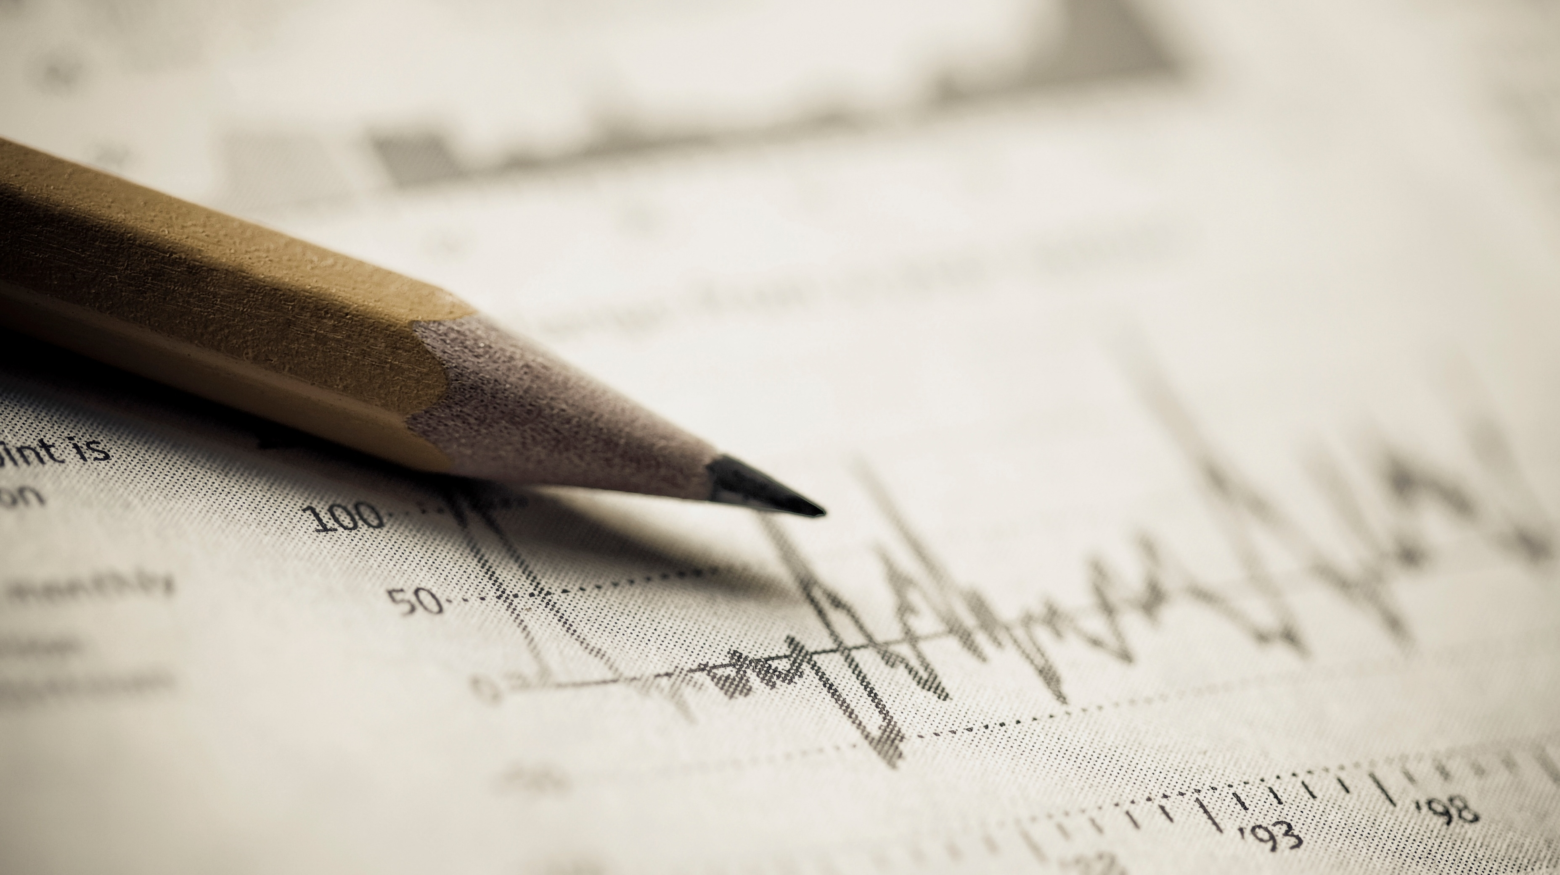
INTRA- BUDDY
1
Project Phase 1
Guided by PROF. R.B.Keskar
TEAM
Shreyas Deshmane BT18CSE016
Hrishikesh More BT18CSE092
Ansh Rathod BT18CSE132
Sachin Gautam BT18CSE122
Pankaj Sharma BT18CSE086

Slide 2
Key Points:
2
What is the problem that we are going to solve?
How we are going to solve the Problem
Input parameters and what will be the output?
How will It facilitate the users?

Slide 3


3
Our team with 200+ Manually examined chart patterns till now
Where to invest?
When to Invest?
User with the source chart will approach our team

Slide 4

What is the problem that we are going to solve?
4
Every challenge has a solution. What matters is the effectiveness of the solution
Every person once in a lifetime decides to invest but doesn’t know either the proper platform or if someone finds a platform doesn’t know Where to invest? When to invest? And How much to Invest ?
So we are trying to come up with a product to help the user to find the best trading opportunity based on technical analysis in the intra-day market.

Slide 5
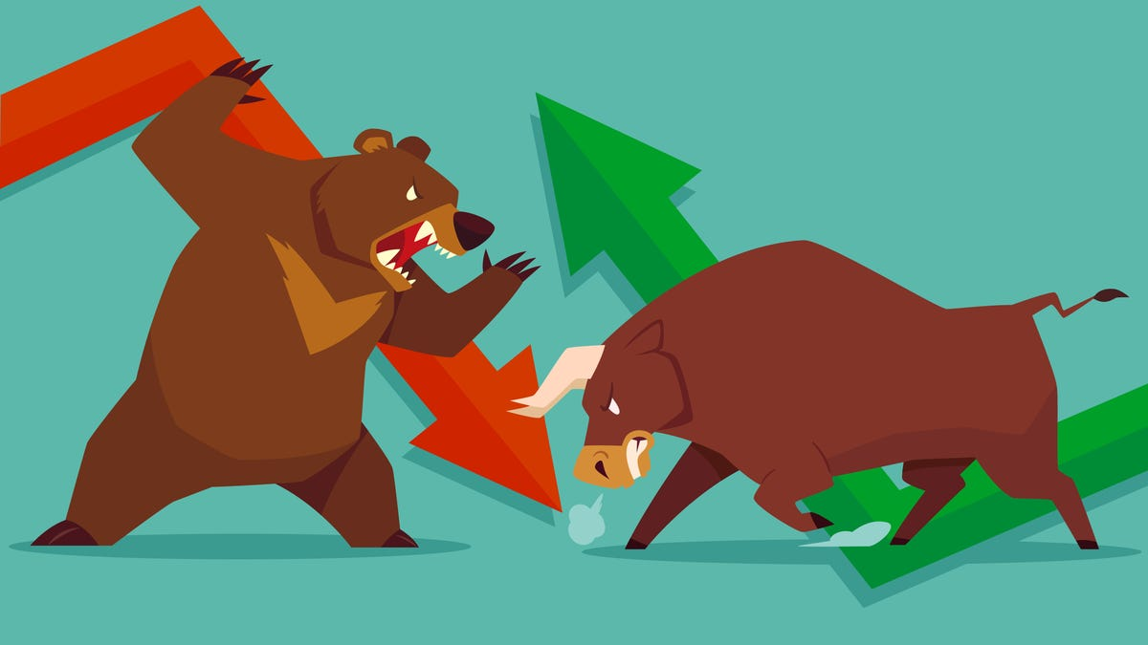
5
How it will work?
When The user inputs the source chart our product will compare the charts with all the charts available in the dataset to find if there is a possible optimum match in the dataset.
After comparing if there is a match present it will check whether it is a bullish double top or Ascending triangle. For example As we know these are bullish Trends so the output for the users will be
“Bullish Nature Detected”
If after comparing there is no match then –
“No pattern detected”

Slide 6
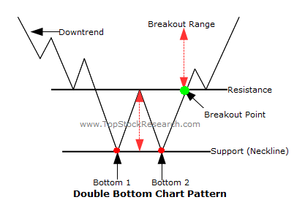
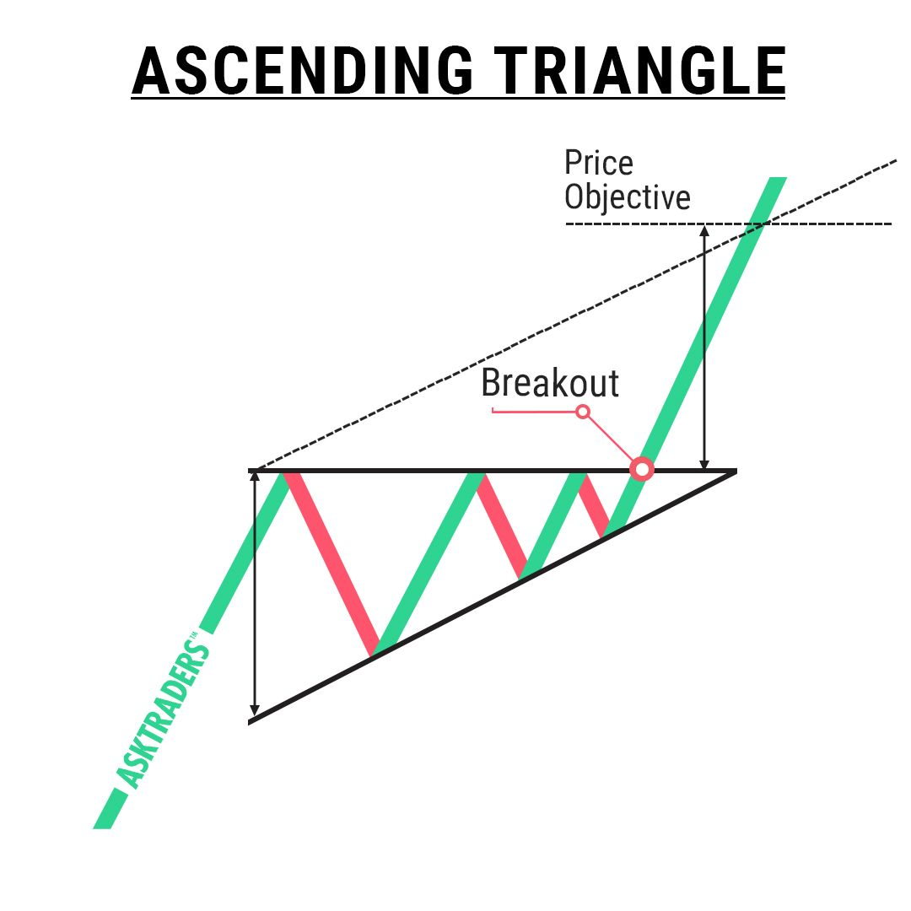
We have Already Created a dataset with 200+ chart patterns manually on two patterns : (i) Bullish double top(Double bottom chart pattern) (ii) Ascending Triangle
6

Slide 7
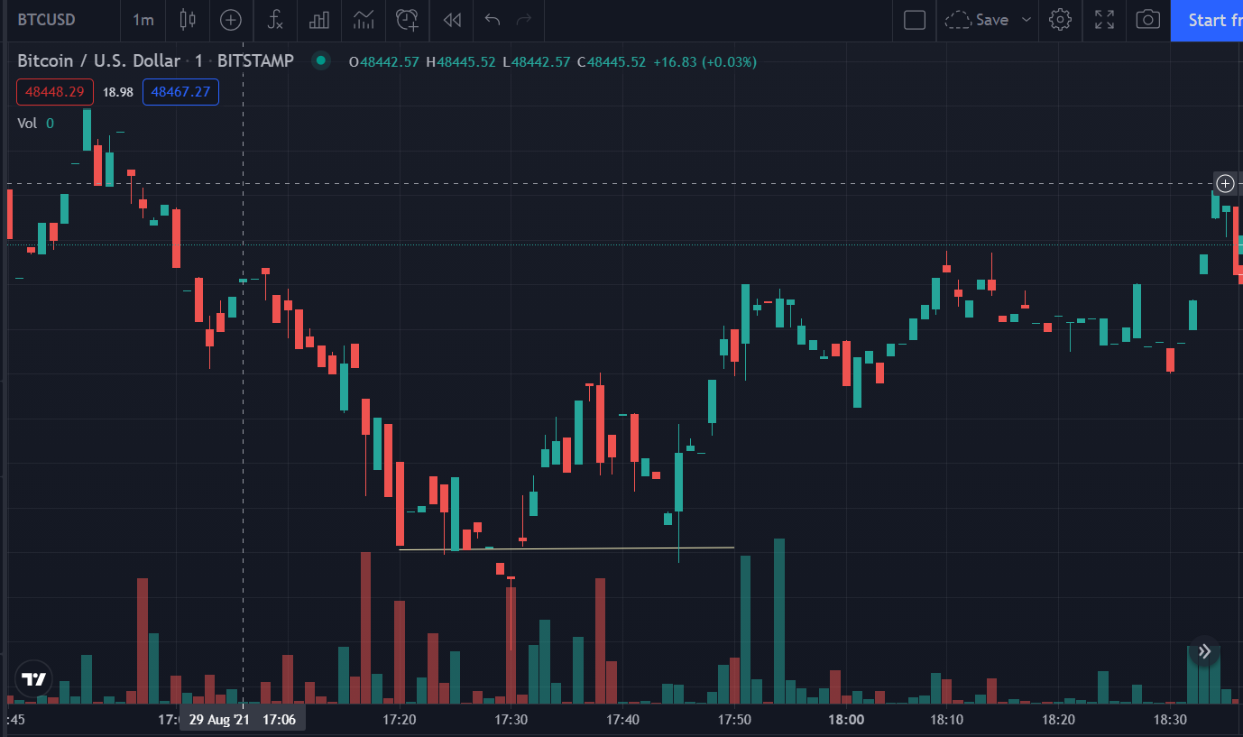
Input and Output Parameters
7
Input :
Taking source image of previous 45mins candlesticks chart in one day(intra-day) column for example

Slide 8
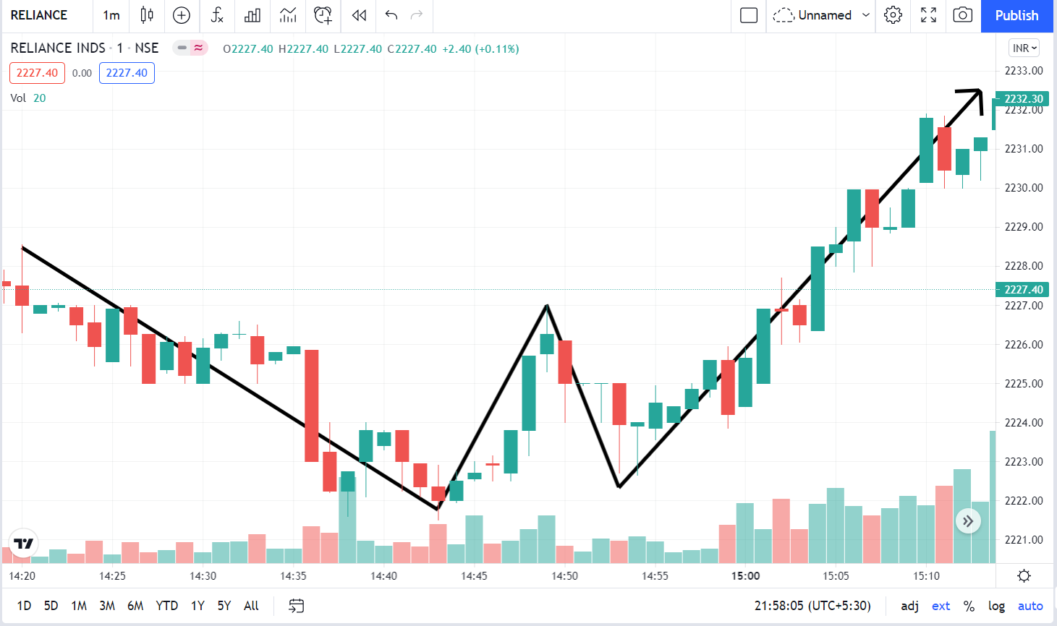
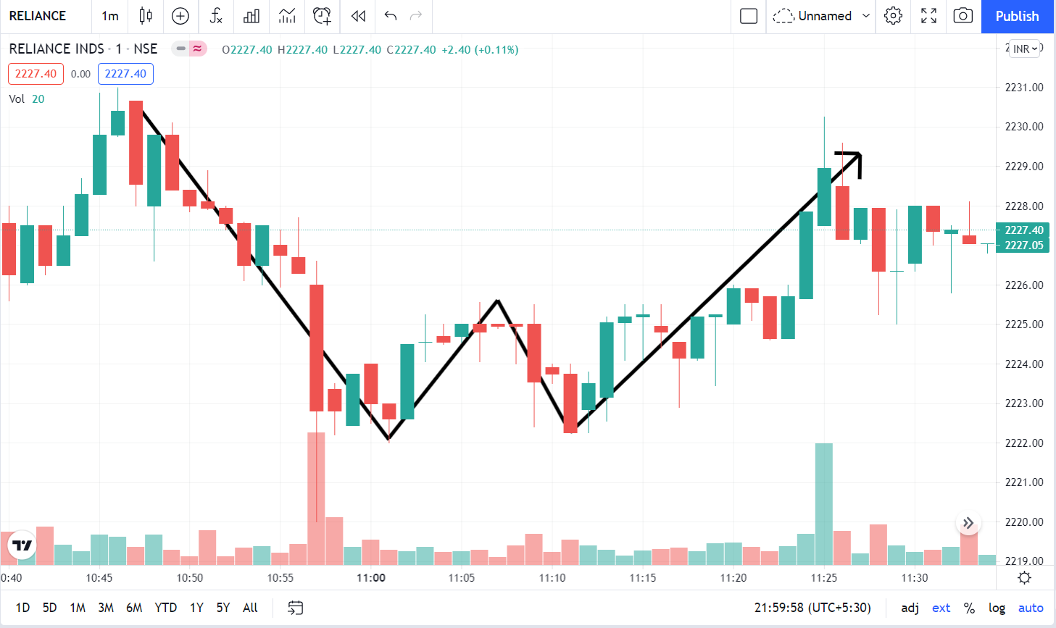
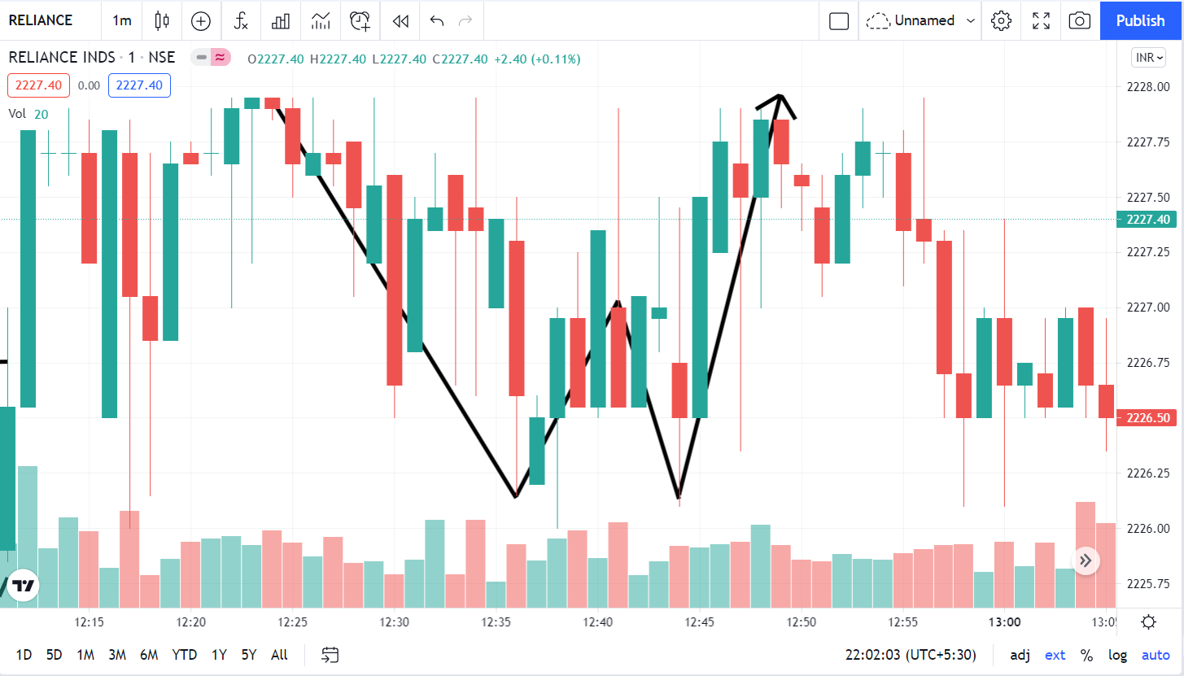
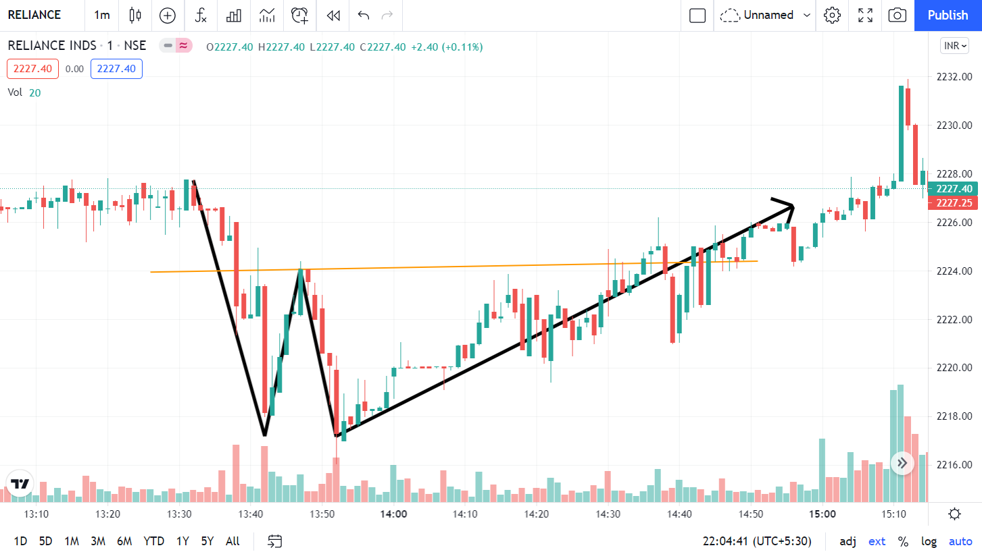
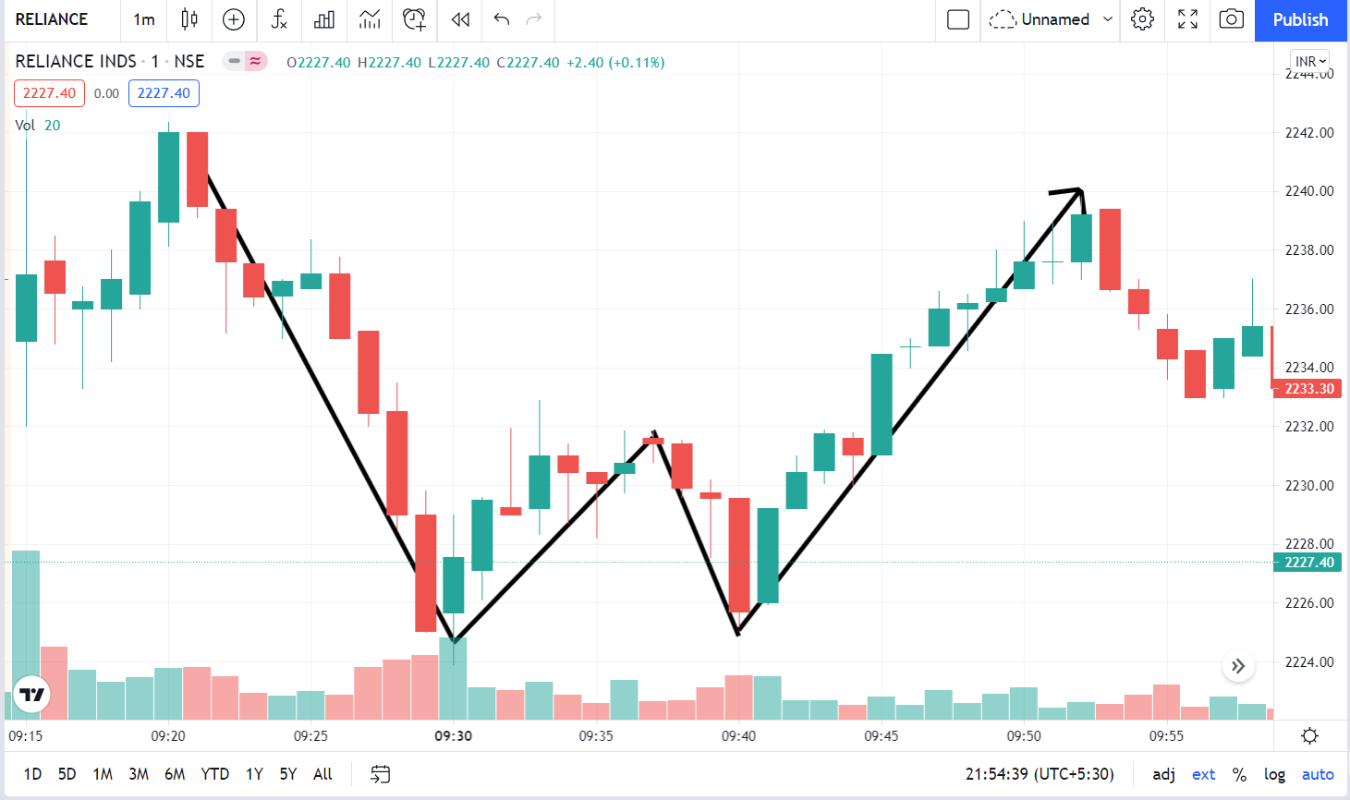
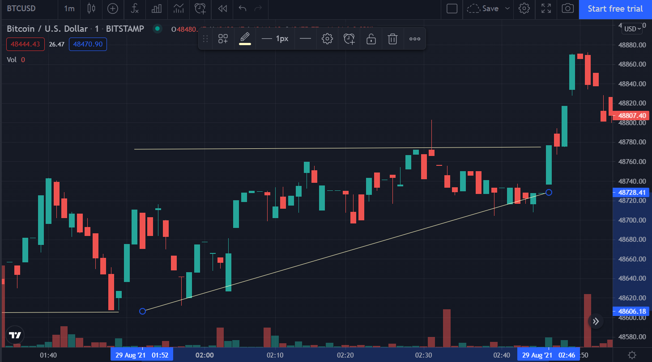
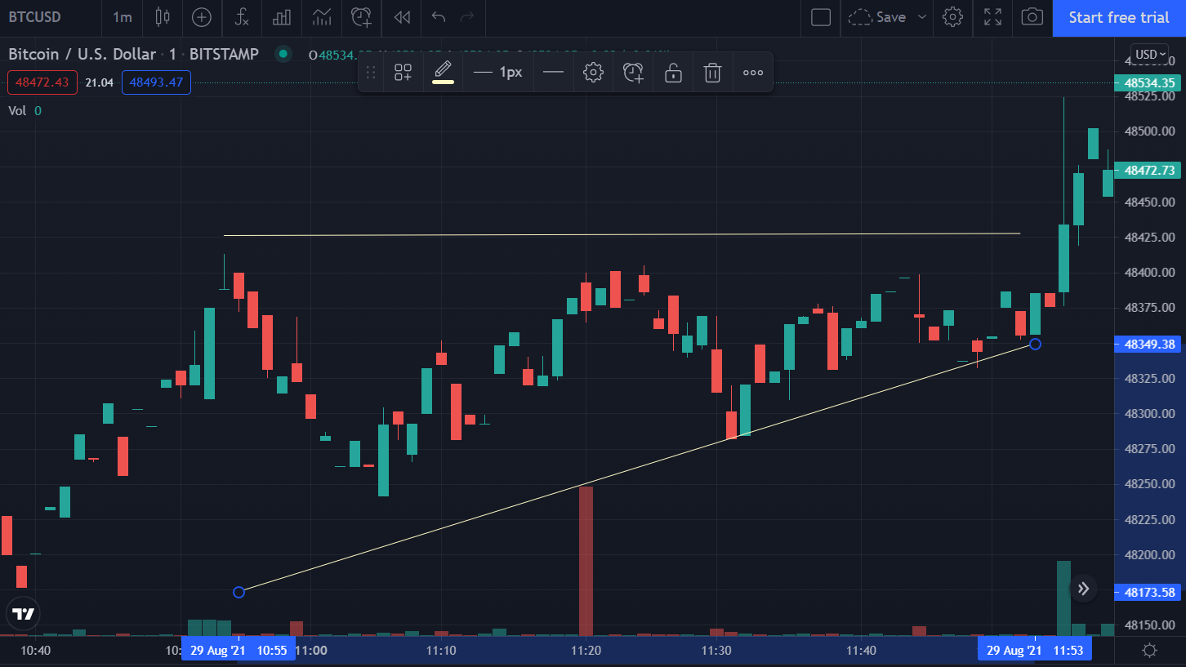
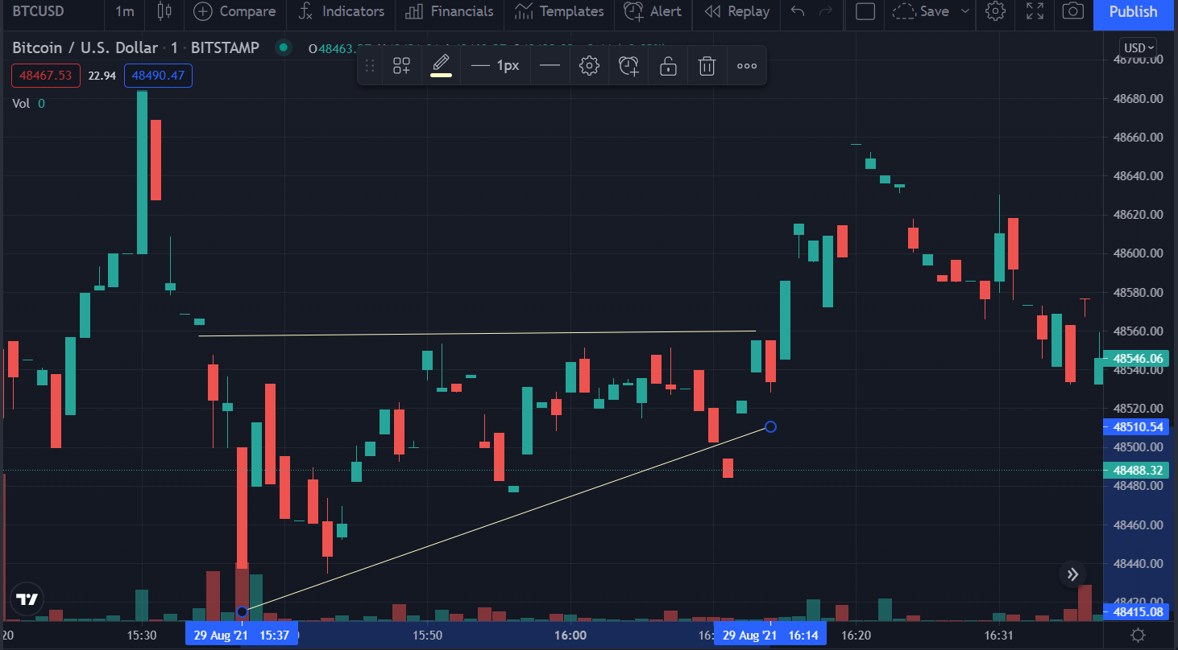
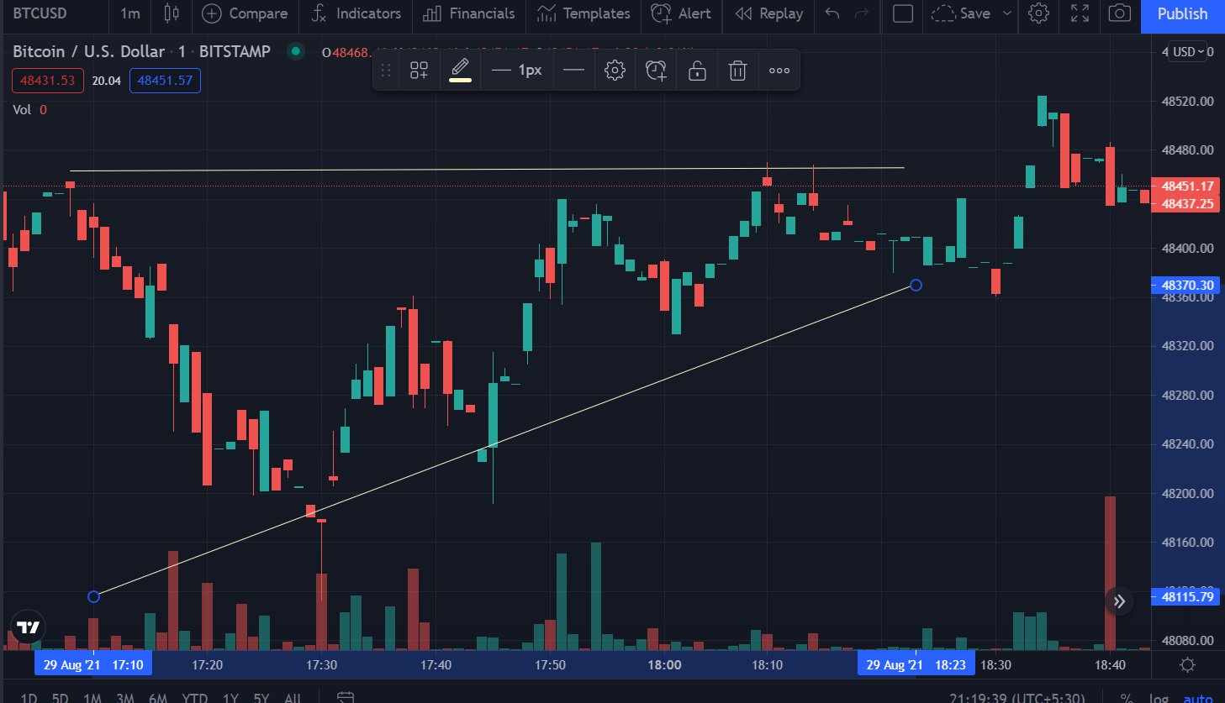
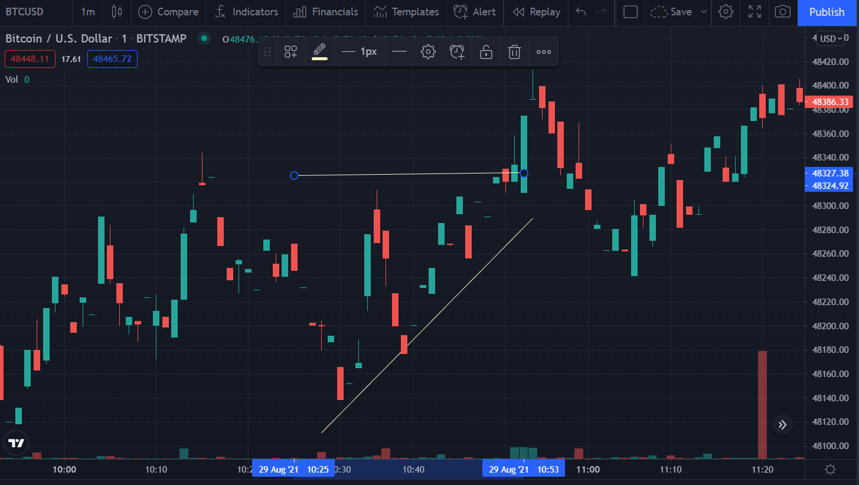
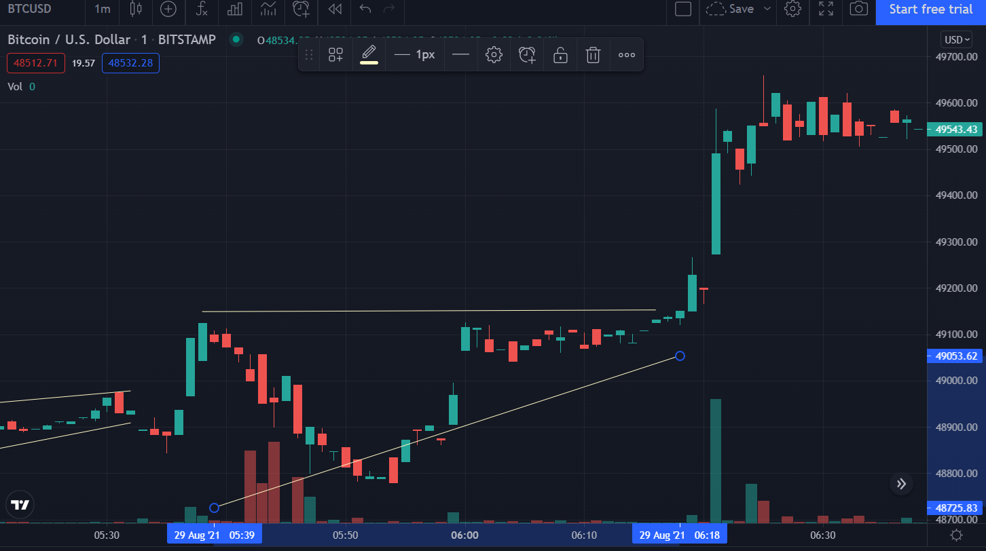
8
User comes up with a Chart pattern in a 45 min window
Our Team with 200+ manually configured dataset
User with the source chart will approach our team
~45mins

Slide 9
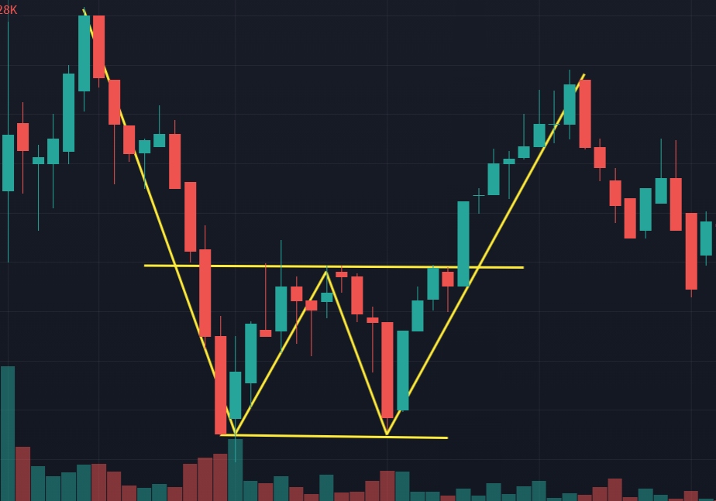
Input and Output Parameters
9
User comes up with a Chart pattern in a 45 min window
Our Dataset
Got something similar
Output :
Whether the chart is present or not , and if present which chart it is

Slide 10
How will It facilitate the users?
10
Our Product will basically help the users to find a proper trade opportunity.
As it is completely based on Technical analysis we can expect a high success rate above 90%.
To overcome with the remaining 10% the user can allot a stop loss ranging from ± 0.25% to ±1% According to the trade the user wants to execute and the maximum risk he can afford.

Slide 11
How we are going to solve the Problem?
11
The problem with estimating the stock price will remain a problem if a better stock market prediction algorithm is not proposed.
So here We are contemplating towards the study of stock market using technical analysis.
This is how we are going to Execute:
Step 1: Adding Lots of Analysed charts in training set
Step 2: Taking input from users for target chart
Step 3: Comparing target chart with all charts available in training sets
Step 4: Finding most optimal amongst them
Step 5: Desired output to the user

Slide 12
12
Possible Algorithms which we are going to work on to find the most optimum solution
CNN
Linear Regression
Time Series
Reinforcement Learning

Slide 13

CNN(convolutional Neural Network)
13
CNN takes input,assign importance to various objects in image and differentiate between them.
2 types of result :
1.convolved feature is reduced in dimension 2.convolved feature increases or remains same in dimension
key architectures-VGGNEt , GoogleNET

Slide 14
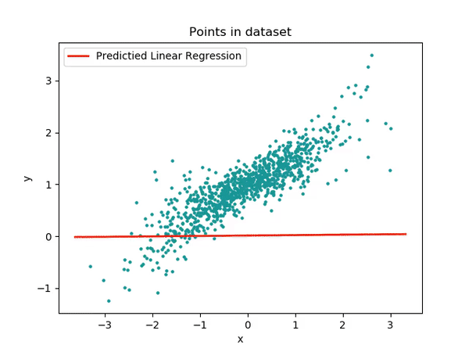
Linear Regression
14
Linear regression is used for predictions with data that has numeric target variable.
During prediction we use some variables as dependent variables and few considered as independent variables.
In situation when there is one dependent and one independent variable, we prefer to use linear regression methodologies.
Regression can be single variable or multi variable, it depends upon situation named as single variable or multi variable regression.

Slide 15
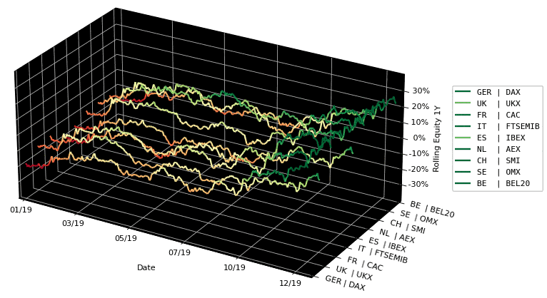
Time Series
15
A time series is a data set that tracks a sample over time.
In particular, a time series allows one to see what factors influence certain variables from period to period.
Time series analysis can be useful to see how a given asset, security, or economic variable changes over time.
Forecasting methods using time series are used in both fundamental and technical analysis.
Although cross-sectional data is seen as the opposite of time series, the two are often used together in practice.

Slide 16

Reinforcement learning (RL)
16
It is an area of machine learning concerned with how intelligent agents ought to take actions in an environment in order to maximize the notion of cumulative reward.
It is one of three basic machine learning paradigms, alongside supervised learning and unsupervised learning.
The main focus is on finding a balance between exploration (of uncharted territory) and exploitation (of current knowledge)

Slide 17
Literature Survey
17
Chavan and Patil (2013) contribute to our understanding of ANN stock market prediction by surveying different model input parameters found in nine published articles. They attempt to find the most important input parameters that produce better model prediction accuracy.
Art Paspanthong ,Nick Tantivasadakarn ,Will Vithayapalert(2019) Convolutional Neural Network model,. RNN models , Support Vector Machine, Baseline Model.This paper explored the usage of multiple machine learning models to predict future prices of stocks. We first simplified our problem to a binary classification problem. Then we narrowed down our data, which consists of multiple indicators, to a smaller and more statistically significant subset.
Things used : Exponential Smoothing Model(ESM), ANN and Support Vector Regression (SVR), Support Vector Machine(SVM), Decision trees, Long Short-Term Memory(LSTM).Conclusion: Hybrid Approach applies a combination of multiple different approaches. One such set-based classifier was used which yields an accuracy of 92.1%.
Things Used : Support Vector Machine (SVM) & Radial Basis Function(RBF)Working: Fetching data from the CSV file,With SVM it will select the dataset value File.After Selecting the dataset file it will show graph befor and after Mapping.After that Predict the value of select stock.Conclusion: SVM algorithm works on the large dataset value which is collected from different global financial markets. Also, SVM does not give a problem of over fitting.

Slide 18
Key Points:
18
Candle Chart
API used
How will API Facilitate in Project
Comparison of API driven charts with Data Set

Slide 19

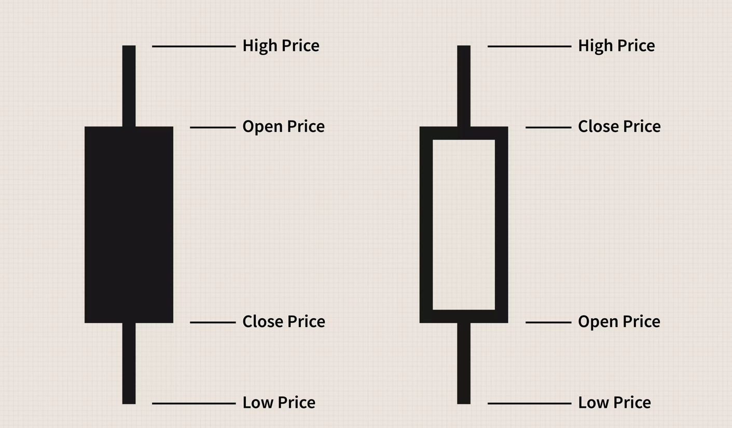
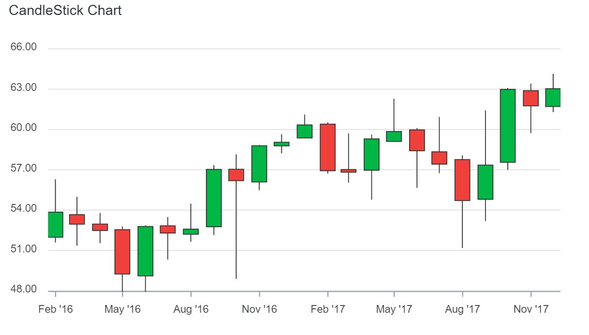
3
19
What is a Candlestick?
This real body represents the price range between the open and close of that day's trading. When the real body is filled in or black, it means the close was lower than the open. If the real body is empty, it means the close was higher than the open.
What is a Candlestick Chart?
Candlestick charts are used to determine possible price movement based on past patterns. Candlesticks show that emotion by visually representing the size of price moves with different colors. Traders use the candlesticks to make trading decisions based on regularly occurring patterns that help forecast the short-term direction of the price.

Slide 20
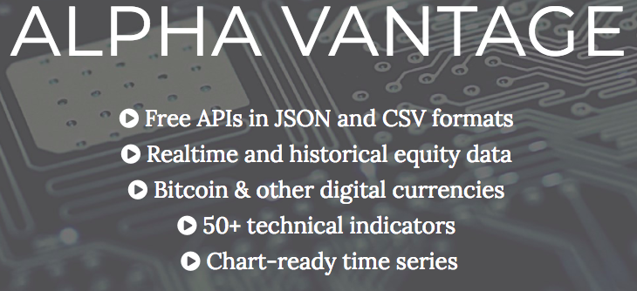
API Used : ALPHA - VANTAGE
4
20
Alpha Vantage provides enterprise-grade financial market data through a set of powerful and developer-friendly APIs.
From traditional asset classes (e.g., stocks and ETFs) to forex and cryptocurrencies, from fundamental data to technical indicators, Alpha Vantage is your one-stop-shop for global market data delivered through cloud-based APIs, Excel, and Google Sheets.

Slide 21
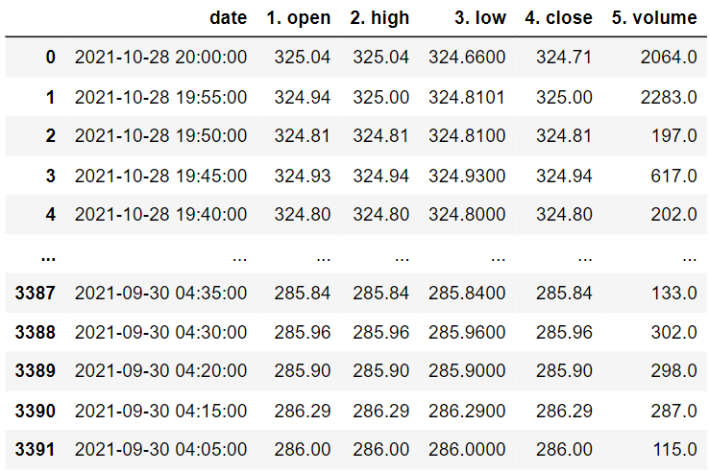
5
21
How will API(Alpha-Vantage)Facilitate in Project
API will provide us with the Candlestick Chart of Desired Stock.
API gathers data of real-time stocks.
It Helps us to have a chart of any time limit ,as mentioned earlier we’ll have a chart of 45min time span in which each candle will be of 5 min

Slide 22
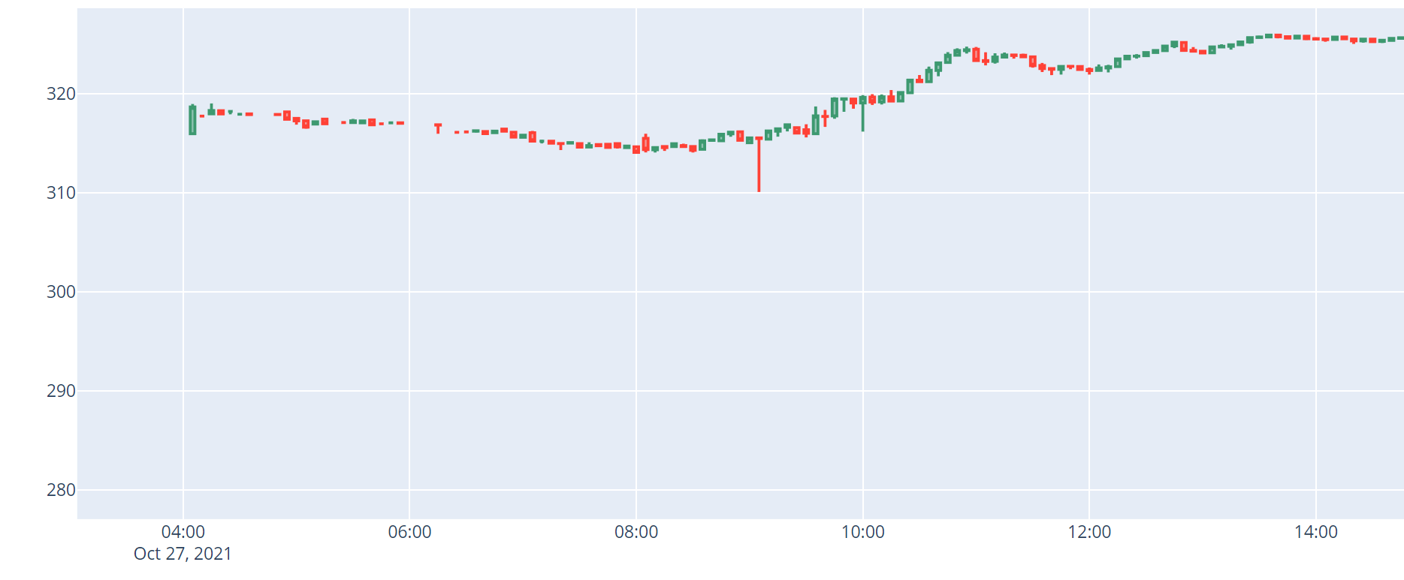
API Gathered data displayed in Charts format using Plotly
6
22

Slide 23
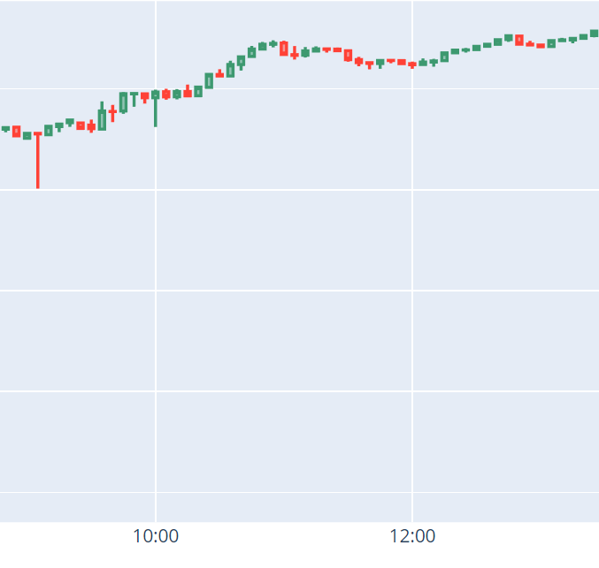
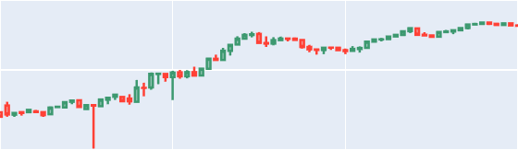
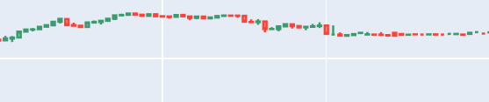
Live Charts formed by API
7
23

Slide 24
DATASET Charts
8
24

Slide 25
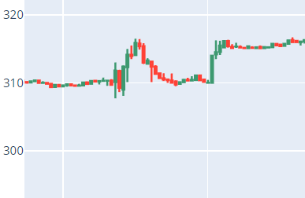
Comparison of API driven charts with Data Set
9
25

Slide 26
Key Points:
26
Dataset Overview
Classification Using CNN
Model Training
Model Testing
Final Obtained Results

Slide 27
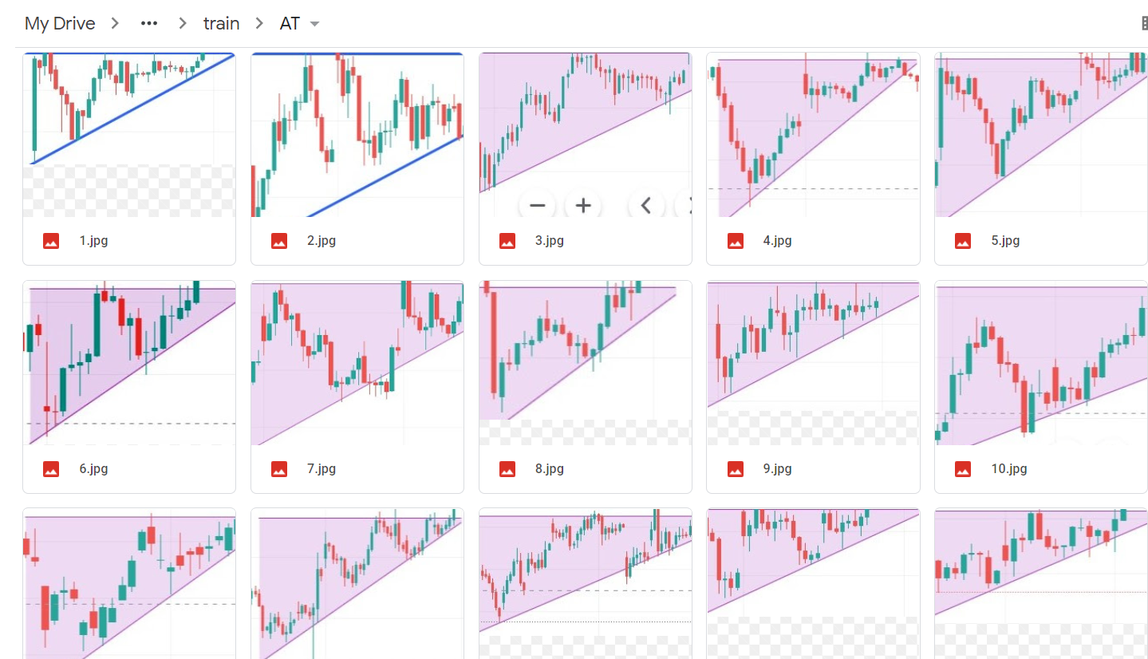
Dataset Overview
27
An ascending triangle is a chart pattern used in technical analysis. It is created by price moves that allow for a horizontal line to be drawn along the swing highs, and a rising trendline to be drawn along the swing lows. The two lines form a triangle. Traders often watch for breakouts from triangle patterns.

Slide 28
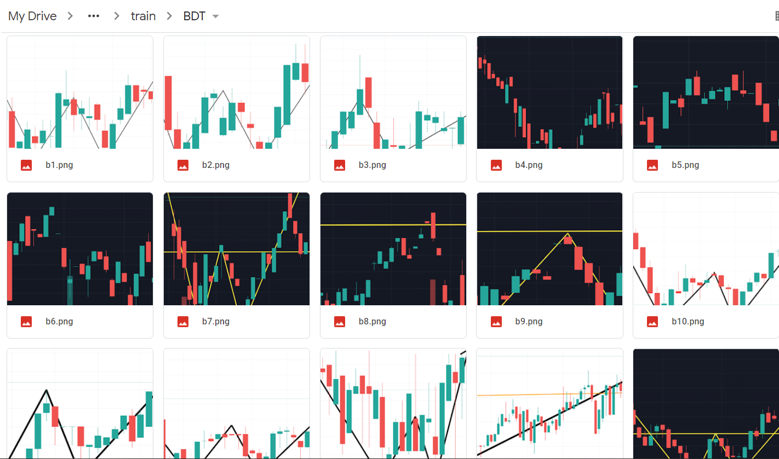
Dataset Overview
28
A double top pattern is a technical analysis charting pattern that describes a change in trend and a momentum reversal from prior leading price action. It describes the drop of a stock or index, a rebound, another drop to the same or similar level as the original drop, and finally another rebound.

Slide 29
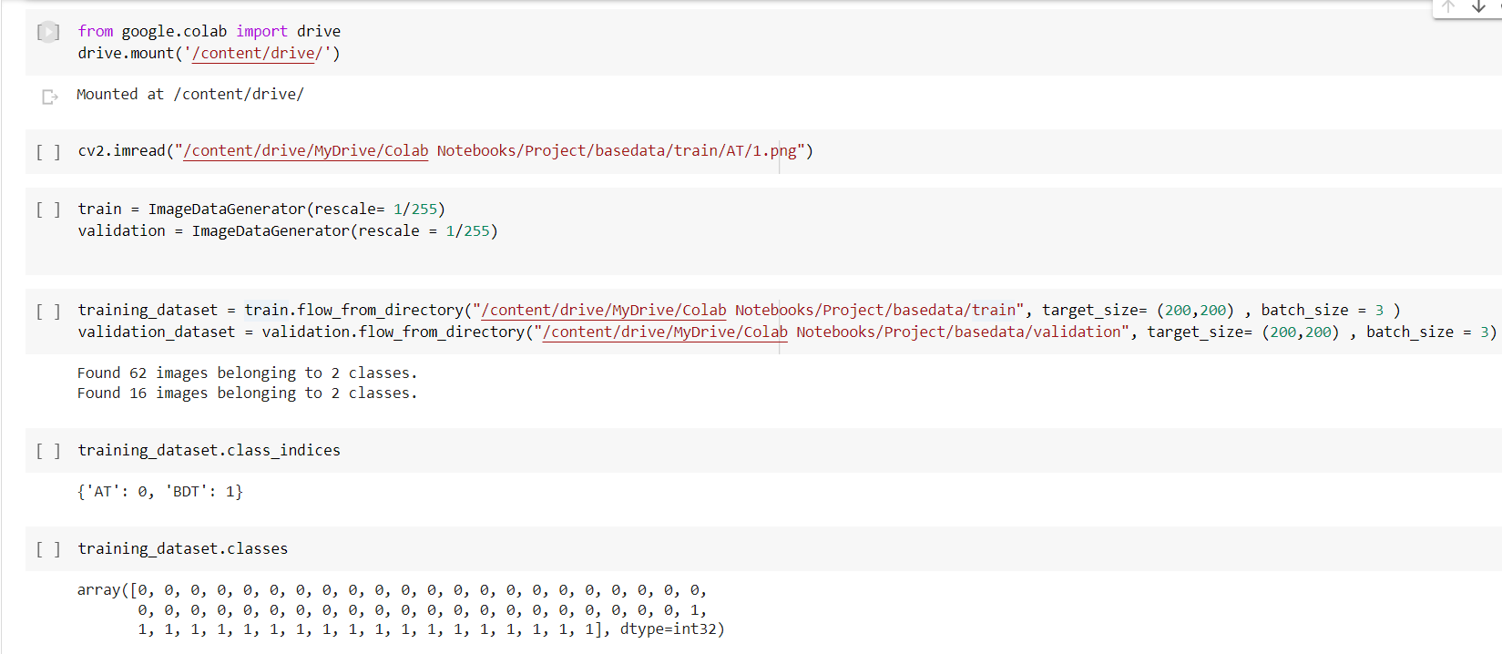
Classification Using CNN
29

Slide 30
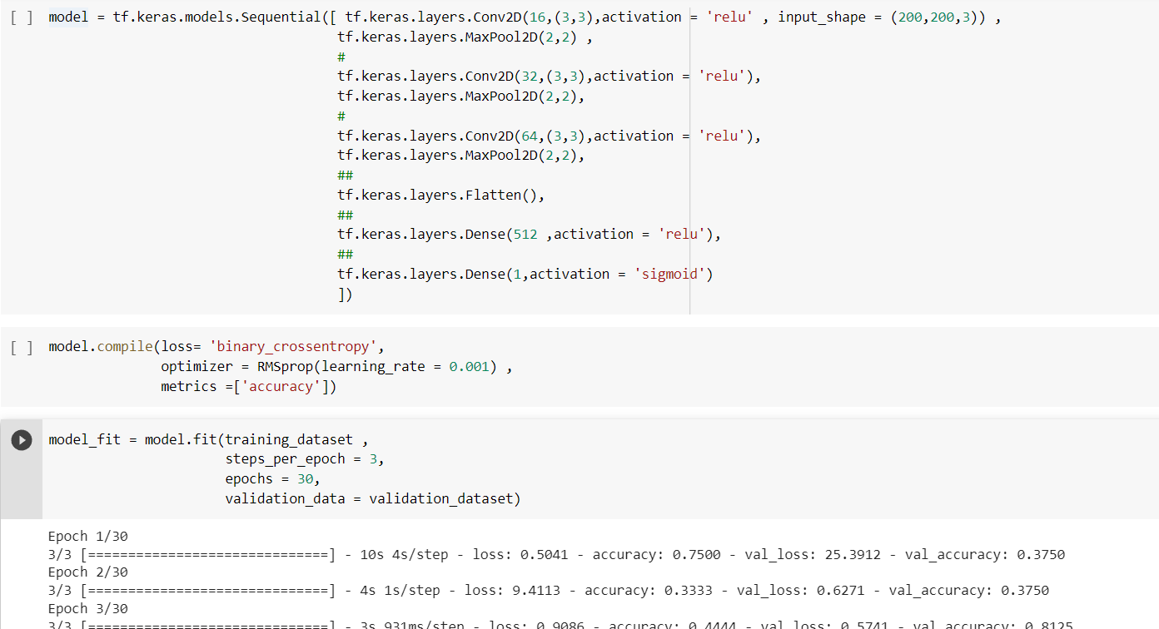
Model Training
30
Model Implementation using Keras
Model Training with 30 Epochs

Slide 31
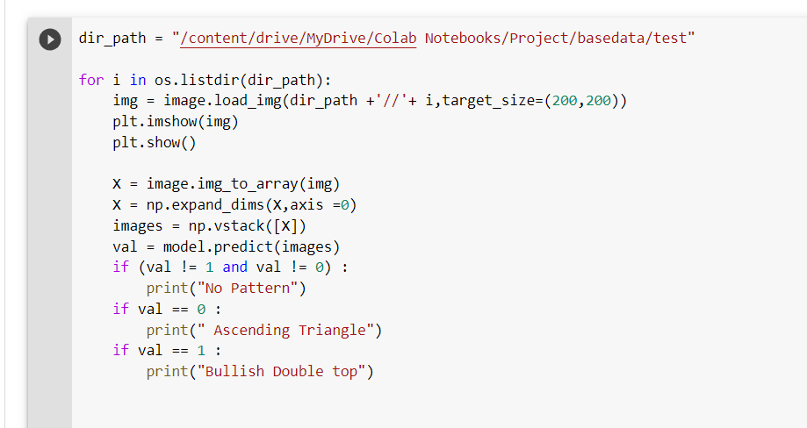
Model Testing
31
Taking Test images at “test” folder and testing all using the CNN Algorithm

Slide 32
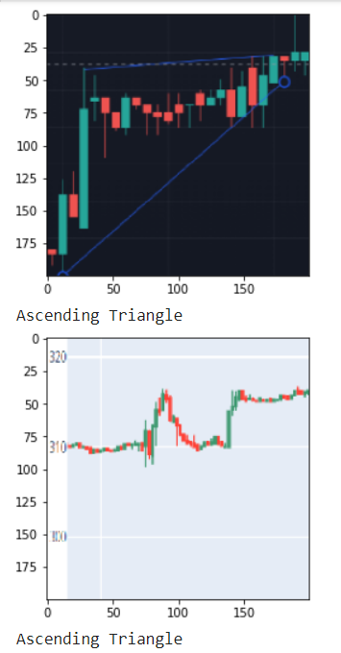
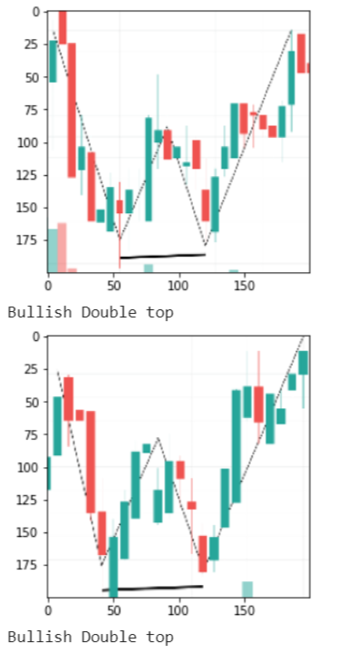
Final Obtained Results
32
Predicted Results With 75%+ accuracy

Slide 33
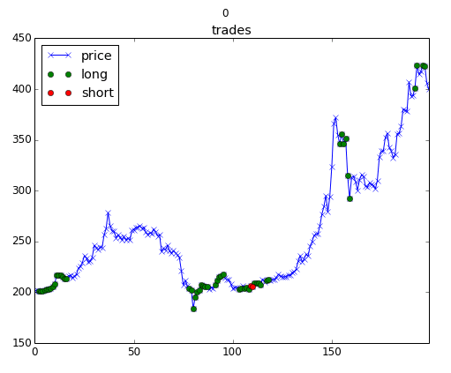
Reinforcement Learning
33
The concept of reinforcement learning can be applied to the stock price prediction for a specific stock as it uses the same fundamentals of requiring lesser historical data, working in an agent-based system to predict higher returns based on the current environment.
We will see an example of stock price prediction for a certain stock by following the reinforcement learning model. It makes use of the concept of Q learning explained further.

Slide 34
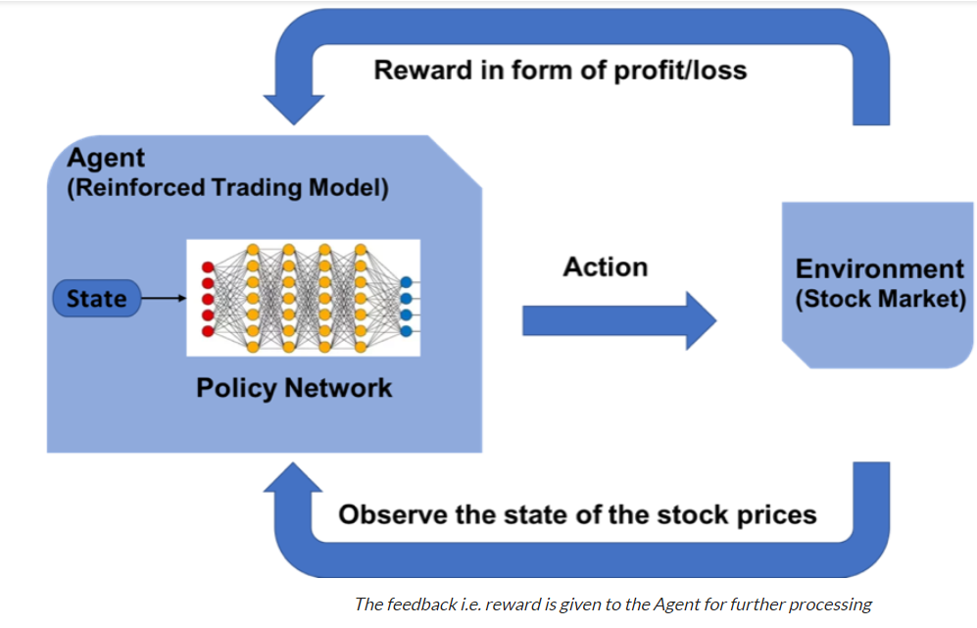
Steps for designing a reinforcement learning model is –
34
Importing Libraries
Create the agent who will make all decisions
Define basic functions for formatting the values function, reading the data file, etc
Train the agent
Evaluate the agent performance
Creating The Environment
Evaluating the model

Slide 35
Define the Reinforcement Learning Environment
35
Agent – An Agent A that works in Environment E
Action – Buy/Sell/Hold
States – Data values
Rewards – Profit / Loss
The Role of Q – Learning : Q-learning is a model-free reinforcement learning algorithm to learn the quality of actions telling an agent what action to take under what circumstances. Q-learning finds an optimal policy in the sense of maximizing the expected value of the total reward over any successive steps, starting from the current state.

Slide 36
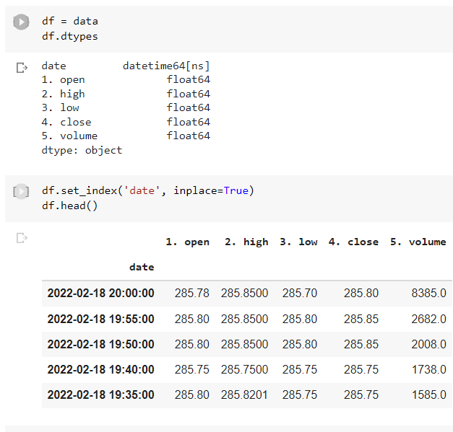
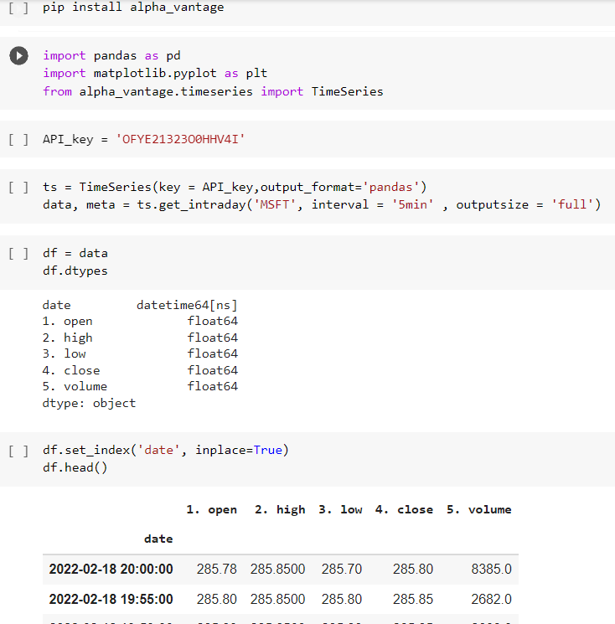
Obtaining Data(5min Timeframe)
36
We’re Feeding the Algorithm with Live Data Gathered through API –Vantage

Slide 37
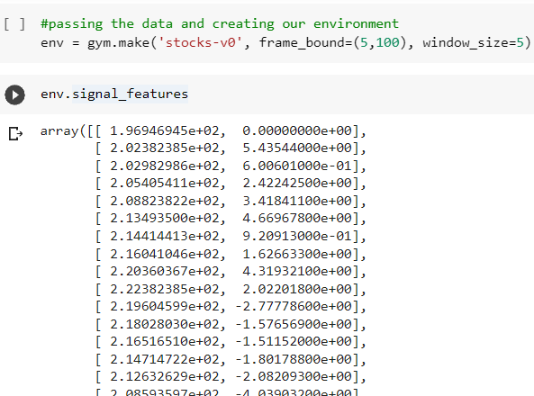
Creating our environment
37
NOTE : Ideally, the data that you use should mimic the frequency that you want to trade. For example, if you want the RL agent to trade daily data, use the daily data to train the agent and not hourly data.
(we’re using 5 min Timeframe )
window_size = previous timesteps our trading bot has as reference points

Slide 38
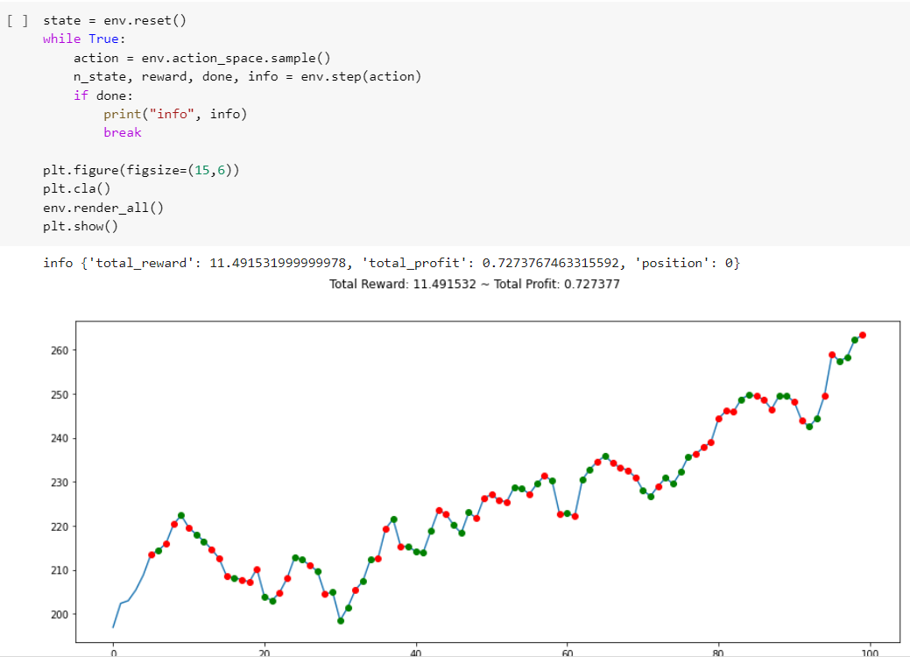
Building the test environment
38
window_size = previous timesteps our trading bot has as reference points
If we look at the actions we can take using environment.action_space, we’ll notice that we only have two actions we can take. We can only Short or Long. In other algorithms, you can Hold.
visualizing the environment using matplotlib.

Slide 39
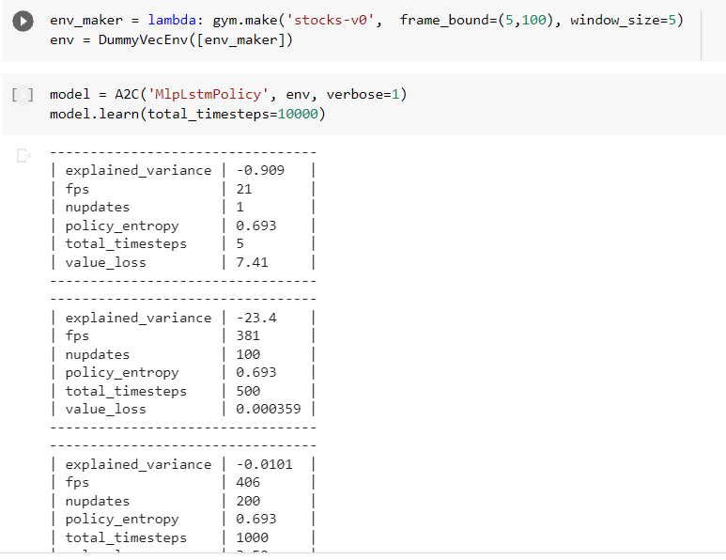
Training an RL agent to trade using the Gym environment
39
We begin by wrapping our environment inside the dummy vectorized environment wrapper, DummyVecEnv.
creating an env_build function. We are taking that function and putting it inside the DummyVecEnv.
Finally, we save the result inside the env variable so that when we start building our training model. We’ll now use the env variable.

Slide 40
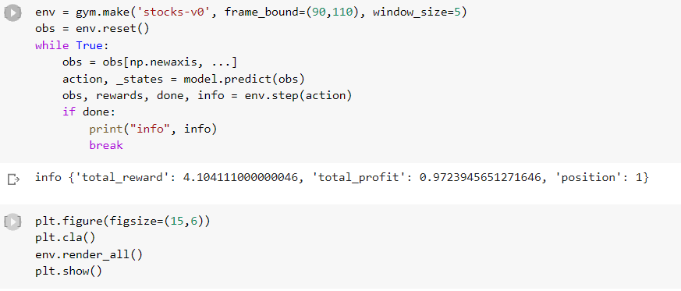
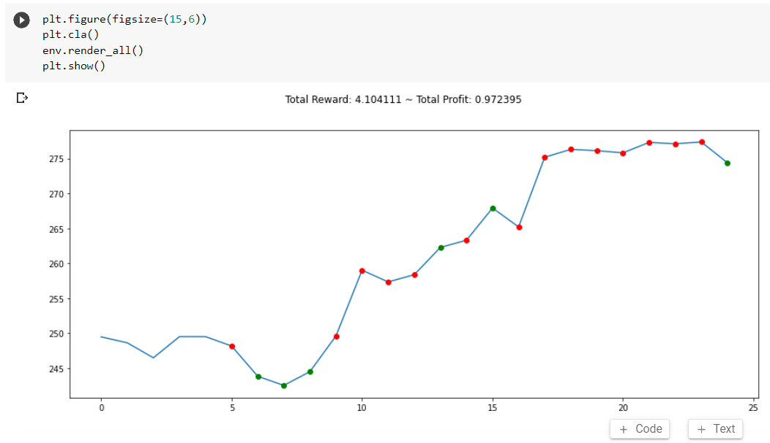
Evaluation
40
As we can see, our agent RL bought and sold stocks at random. Our profit margin appears to be greater than 1, so we can determine that our bot has made us profit from the trades it has made. But these were random steps, now let’s properly train our model to get better trades.
The model isn’t perfect. It has made some long and short trades. Some good and bad trades .With a few tweaks, this model can be trained to trade with stocks, forex, equities, and securities.

Slide 41
Time Series
41
A time series is a data set that tracks a sample over time.
In particular, a time series allows one to see what factors influence certain variables from period to period.
Time series analysis can be useful to see how a given asset, security, or economic variable changes over time.
Forecasting methods using time series are used in both fundamental and technical analysis.
Although cross-sectional data is seen as the opposite of time series, the two are often used together in practice.

Slide 42
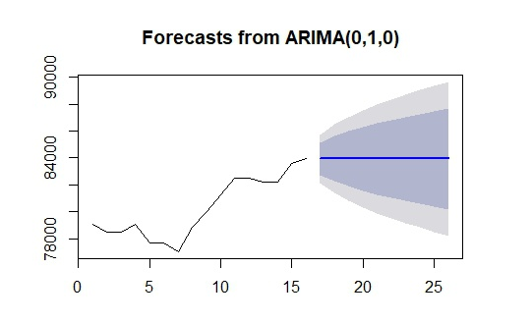
What is ARIMA?
42
Before working with non-stationary data, the Autoregressive Integrated Moving Average (ARIMA) Model converts it to stationary data. One of the most widely used models for predicting linear time series data is this one.
The ARIMA model has been widely utilized in banking and economics since it is recognized to be reliable, efficient, and capable of predicting short-term share market movements.

Slide 43
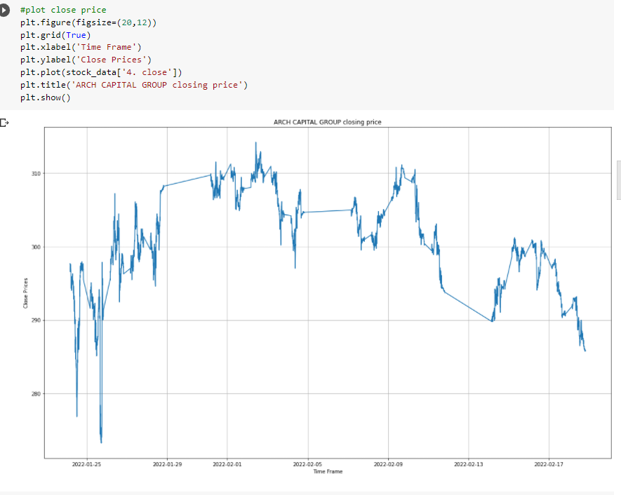
Plot close price
43

Slide 44
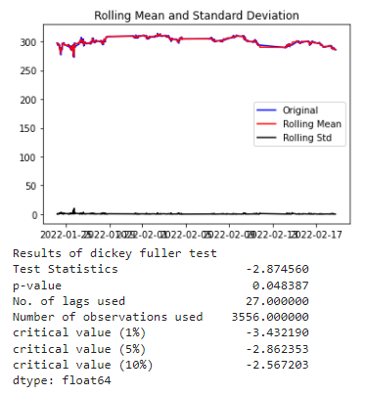
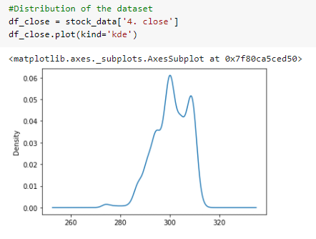
Test for stationarity
44

Slide 45
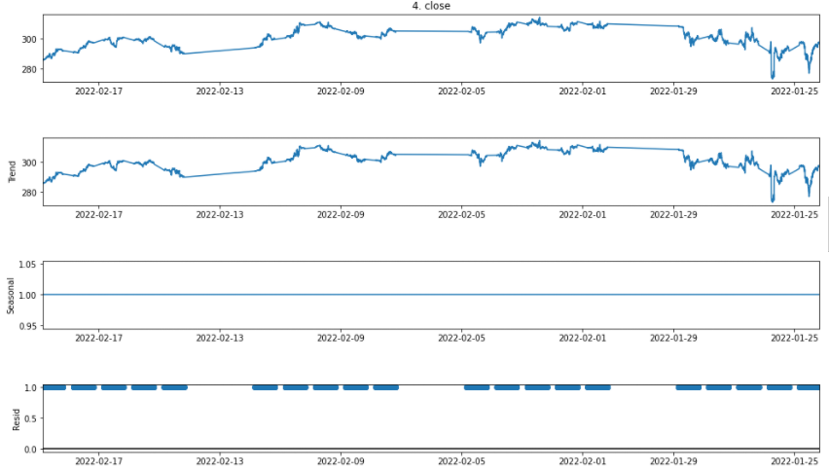
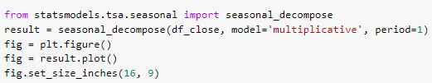
we can decompose the series using the following code.
45
Separating the trend and the seasonality
from a time series

Slide 46

Split data into train and training set
46

Slide 47


ARIMA Model
47

Slide 48

Visual Summary Of ARIMA Model
48

Slide 49

Trained Arima Model
49

Slide 50

Linear Regression
Linear regression is used for predictions with data that has numeric target variable.
During prediction we use some variables as dependent variables and few considered as independent variables.
In situation when there is one dependent and one independent variable, we prefer to use linear regression methodologies.
Regression can be single variable or multi variable, it depends upon situation named as single variable or multi variable regression.

Slide 51

Select Subset with relevant features
We use the 5 min Timeframe closing price Close as the value to predict, so we can discard the other features.
‘Close' column has numerical data type
The 'Date' is the index column and contains datetime values

Slide 52


Explore the Data
When we take a look at the price movement over time by simply plotting the Closing price vs Time, we can already see, that the price continously increases over time and we can also estimate that trend could be linear.

Slide 53


Linear Regression Formulation
Our data contains only one independent variable (X) which represents the date and the dependent variable (Y) we are trying to predict is the Stock Price. To fit a line to the data points, which then represents an estimated relationship between X and Y, we can use a Simple Linear Regression.
The best fit line can be described with where,
The goal is to find such coefficients β0 and β1 that the Sum of Squared Errors, which represents the difference between each point in the dataset with it’s corresponding predicted value outputted by the model, is minimal.

Slide 54


Training Linear Regression Model

Slide 55


Slide 56


Linear Regression | Price vs Time

Slide 57


Predicted Vs Actual Price

Slide 58


Normal v/s Residual Histogram Distribution

Slide 59


Evaluation

Slide 60
References
18
50
Chavan, P. S., & Patil, S. T. (2013). Parameters for stock market prediction. International Journal of Computer Technology and Applications, 4(2), 337.
Machine Learning in Intraday Stock Trading ,Name : Art Paspanthong , Nick Tantivasadakarn , Will Vithayapalert Institute : Stanford University Date of Publication: Spring 2019
School of Computing, Queen’s University, Kingston, ON K7L 2N8, Canada; dshah@cs.queensu.ca (D.S.); farhana@cs.queensu.ca (F.Z.) Correspondence: isah@cs.queensu.ca Received: 4 March 2019; Accepted: 15 May 2019; Published: 27 May 2019
Stock Market Prediction using Machine Learning Name : Kranthi Sai Reddy Vanukuru Institute : Srineedhi Institue Of Science & Technology Date of Publication: November 2018
Stock Market Prediction Using Machine Learning(ML)Algorithms M Umer Ghani, M Awais and Muhammad Muzammulla Department of Software Engineering, Government College University Faisalabad 2019

Slide 61
Timeline
51
Work Done Till 1st Presentation
Work Done Till 2nd Presentation
Work Done Till ^{3rd} Presentation
Idea Discussion
Literature Survey
Manual Dataset Creation
Finding Possible Algorithms
Finding API(Alpha-Vantage) required for gathering real-time stocks Data
Studied about Library(PLOTLY) that help us to plot Candlestick Chart
Dataset Overview
Classification Using CNN
Model Training
Model Testing
Final Obtained Results

Slide 62
Timeline
52
Work done till 4th Presentation
Work done till Now
Work to be done till next Presentation
Worked On Reinforcement Learning and Obtained The Output
Worked On Time Series Trained the Model
Worked On Linear Regression Model,
Comparing All the output results from all four Machine learning Algorithms.
Creating A final report.

